Slide 1
two ugly girls fighting -SENTIMENT/EMOTION ANALYSIS OF A COLLEGE FOOTBALL RIVALRY GAME
Part 1: Melvin Tanner
Part II: HUAN KUANG
PART III: ZEYUAN JING

Slide 2
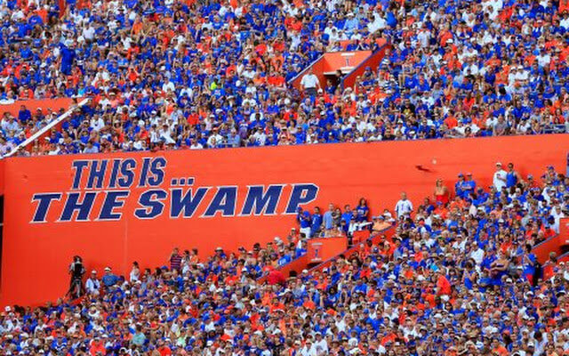
Introduction
College Football is an integral part of U.S. athletic entertainment industry (Nixon, 2014)
College football generated $3.4 billion in 2013 (Gaines, 2014)
Game day dominates college campuses (Toma, 2003)

Slide 3
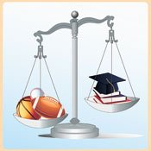
Football success benefits the university
Athletic success can substantially increase national recognition of universities, regardless of academic reputation (Goff, 2000)
Football (and basketball) success increase the quantity of applications each year, without a reduction in the quality of applications as based on SAT scores (Pope & Pope, 2009)
Football success is positively related to freshman retention rates (Mixon & Trevino, 2005)

Slide 4
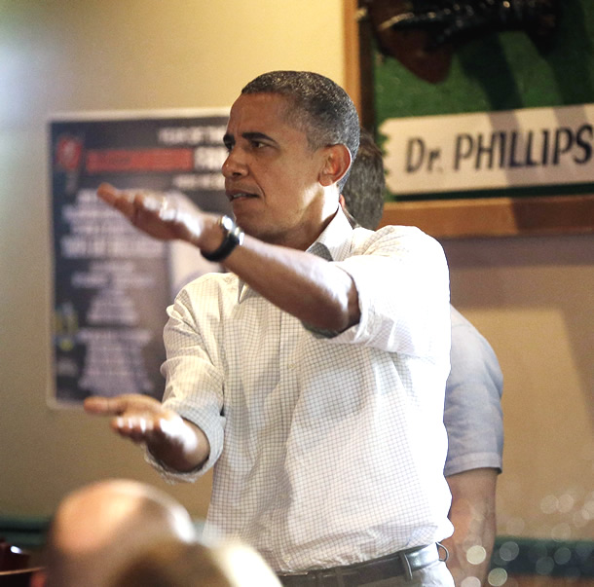
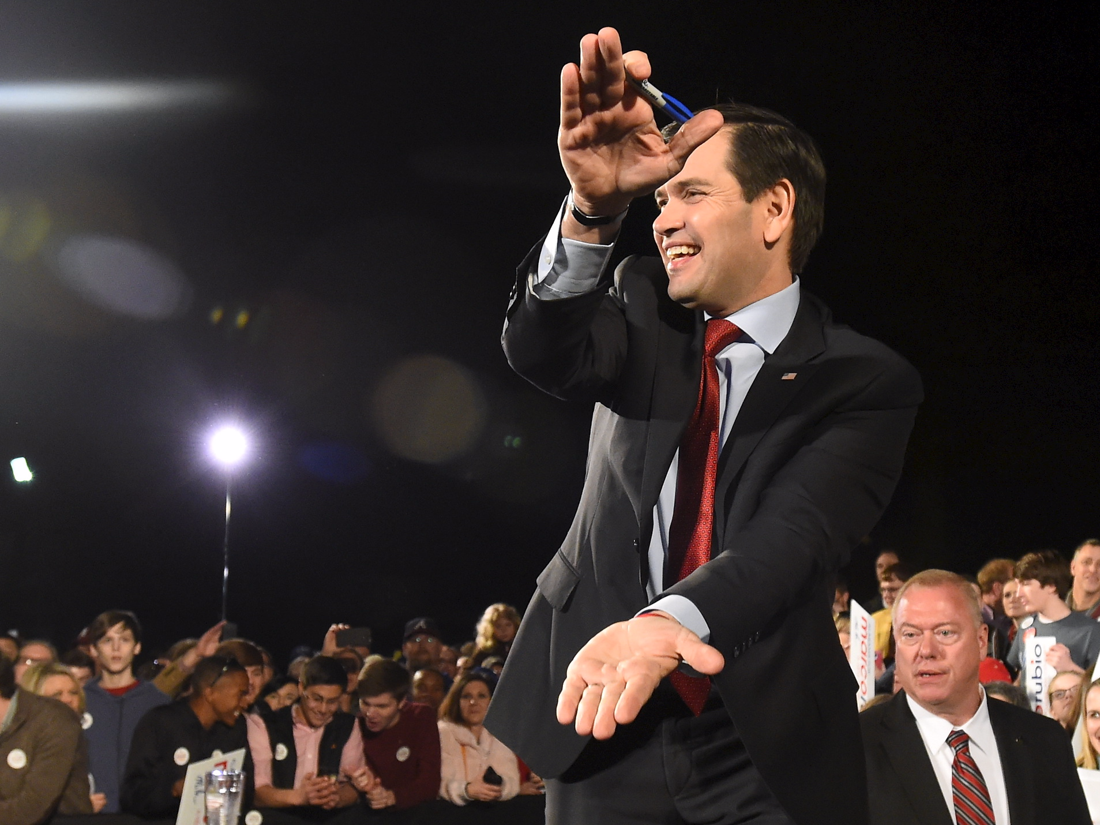
Football success influences decision makers
Institutions with successful football teams receive 3% to 8% increases in state appropriations the following year, especially if they beat an in-state rival. (Humphries, 2003)
College football is one of the few ways that a flagship university engages the community at large (Weerts, 2014).

Slide 5
Research question
What key thoughts do fans express about in-state rivalry games?
How do sentiments about the game vary across different regions of the state?

Slide 6
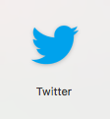
Why twitter?
Twitter as one of the most popular social media platform contains enormous information.
Twitter is also famous as the real-time data resource.
There are a lot of published articles based on Twitter data as well.
It is free comparing with Instagram ($25 for each request)

Slide 7
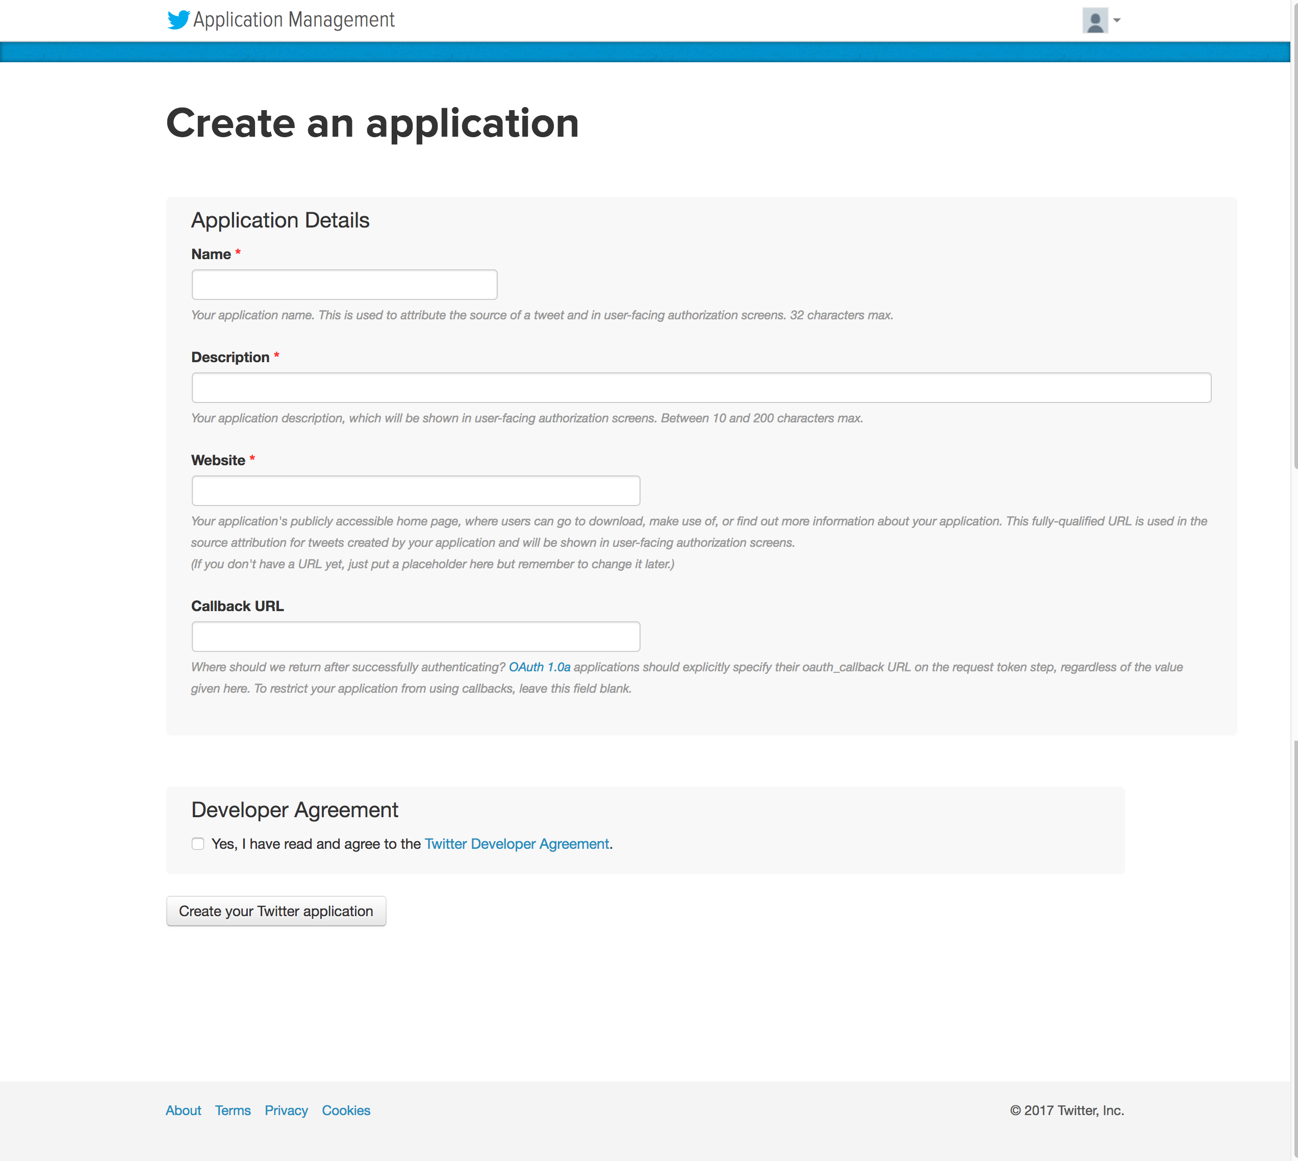
Method: data COLLECTION
1. Get access to Twitter API
https://developer.twitter.com
Create account
Get the keys
Limitation: Can only get 7days

Slide 8
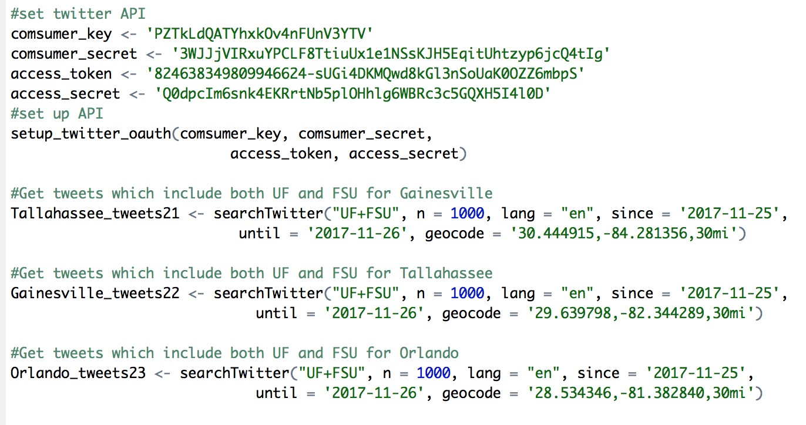
Method: data COLLECTION
2. Search Tweets via R based on the API
Set the location
Set the keywords “UF” and ”FSU”
Set the date

Slide 9
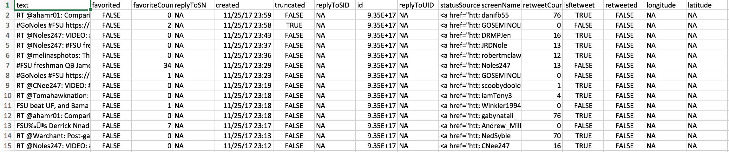
Method: data COLLECTION
Cities | Number of Tweets (from 25-26)
Tallahassee | 635
Gainesville | 87
Orlando | 109
Tampa | 271
Note: Remove Jacksonville=35

Slide 10
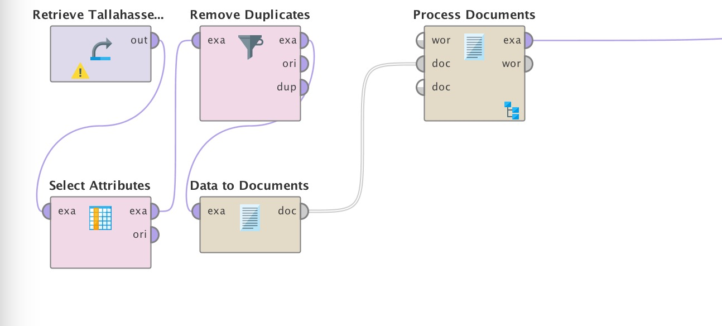
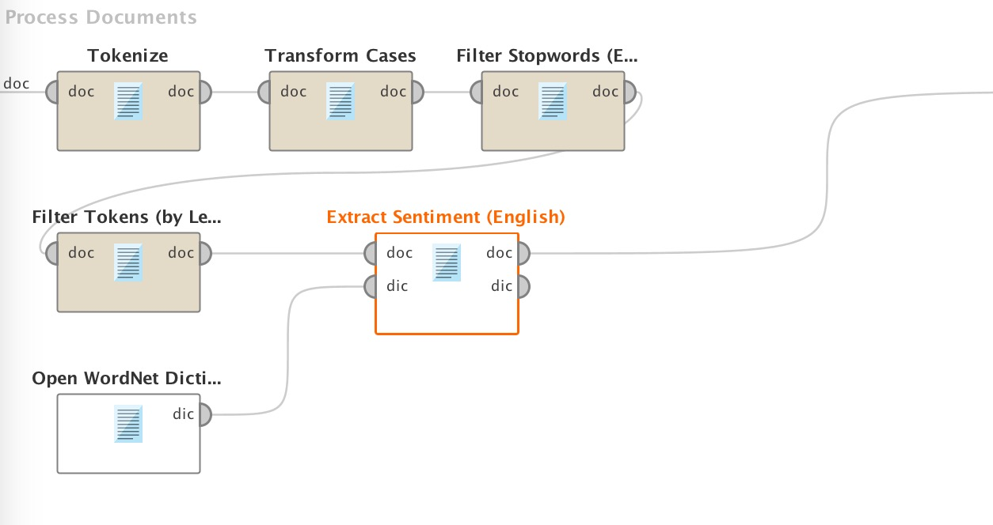
Method: Sentiment analysis
Analyze the sentiment by using Rapid minder

Slide 11
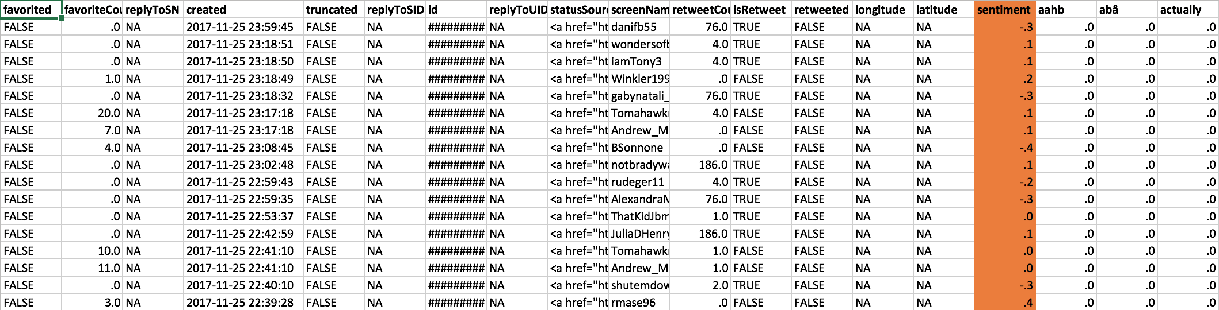
Method: Sentiment analysis
Analyze the sentiment by using Rapid minder
Notes:
Negative sentiment is negative on the matchup more so than negative on either team.

Slide 13
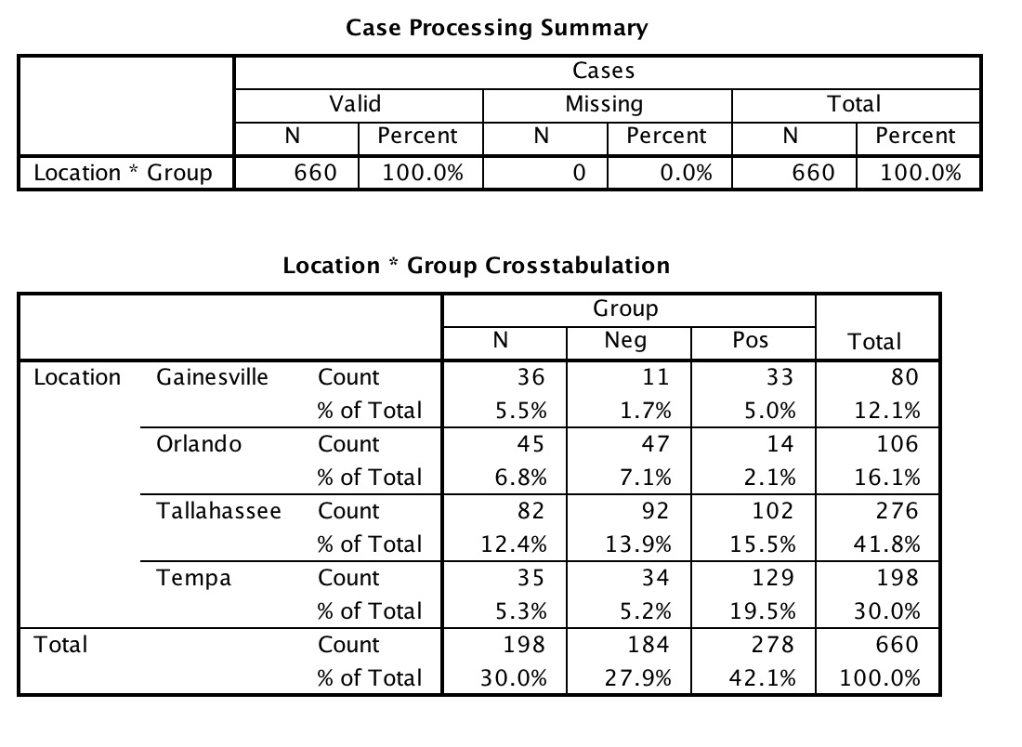

Slide 14
Method: Sentiment analysis
Positive | Neutral | Negative
TAL - Doak in the background but loving @tompetty in this FSU UF gameday. https://t.co/ve8IHcQDia (.6) | TAL-I am from Orlando and growing up nobody was a UCF fan.... Either FSU or UF. So where did you all come from?(.0) | TAL - FSU football did bad this year, but at least not UF bad (-.5)
GNV - Touchdown Florida. After UF regains possession at FSU's 24-yard line off a Duke Dawson interception, Mark Thompson https://t.co/gLpbP7XrSh (.5) | GNV-Nice special teams play all around for UF, which I havenâ€™t said much this year. Great punt, great coverage. FSU will start at its own 12. (.0) | GNV- The UF FSU game is going to be a dumpster fire (-.3)
ORL-In all honesty UCF and USF balled out this year. Damn good teams who would put up a great fight against both UF andâ€¦ https://t.co/DQXqtXPLeD (.2) | ORL - If a college football game could end in a tie, I'd definitely want it to be FSU and UF (.0) | ORL - It's so bad now that FSU players are barely celebrating and UF guys are holding out hands for FSU guys to help them up. I don't even recognize this rivalry. Say it ain't so, Tebow. (-.3)
TAM- He got lucky on that one! UF is a sink hole for a job. Miami is on the up (.8) | TAM - UF always brings out the best in this FSU team. (.0) | TAM - UF vs. FSU being described as two ugly girls fighting made my day (-.5)
Example:
Notes:
Very little commentary about the actual game. People may not have been watching or felt uninspired.

Slide 15
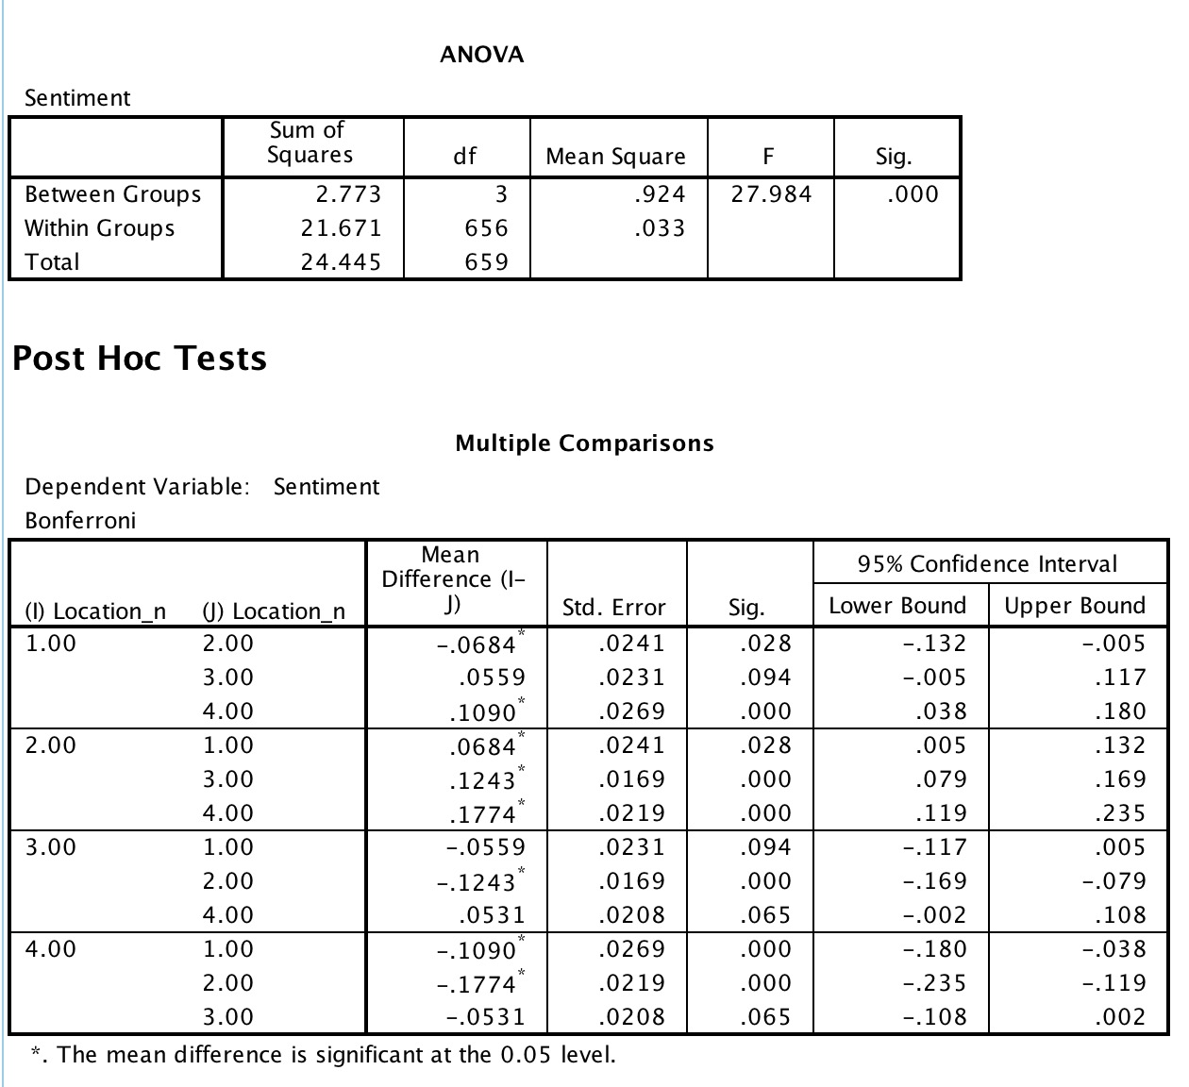
1=Gainesville
2=Tampa
3=Tallahassee
4=Orlando

Slide 16
Word cloud
an image composed of words used in a particular text or subject, in which the size of each word indicates its frequency or importance.
Make word cloud for each city based on the tweets on UF vs. FSU football game day.

Slide 17
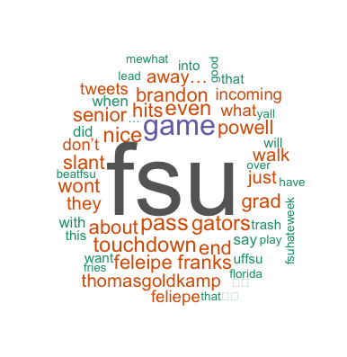
Word cloud for Gaine-sville

Slide 18
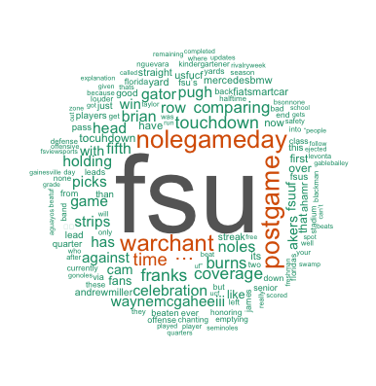
Word cloud for Tallaha-ssee

Slide 19
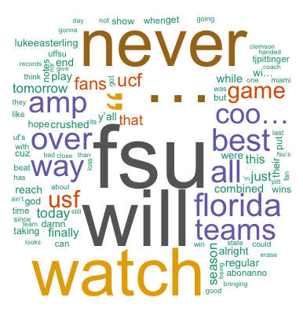
Word cloud for tAMPA

Slide 20
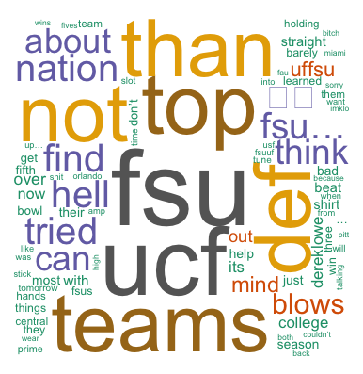
Word cloud for oRLANDO

Slide 21
The Emotion of tweets
Tweets can reflect people’s emotions and aspects to a particular event.

Slide 22
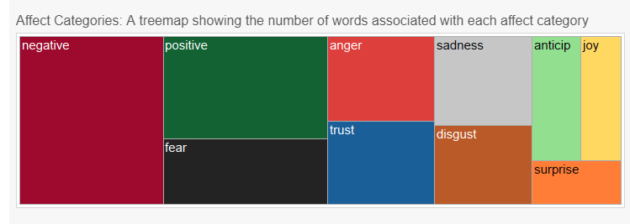
NRC Word-Emotion Association Lexicon
http://saifmohammad.com/WebPages/NRC-Emotion-Lexicon.htm
The NRC Emotion Lexicon is a list of English words and their associations with eight basic emotions (anger, fear, anticipation, trust, surprise, sadness, joy, and disgust) and two sentiments (negative and positive).

Slide 23
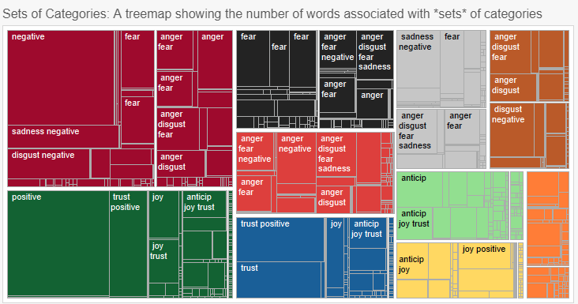
NRC Word-Emotion Association Lexicon
classifies words into eight primary emotions categories based on Plutchik’s psycho-evolutionary theory and also positive and negative emotion categories

Slide 24
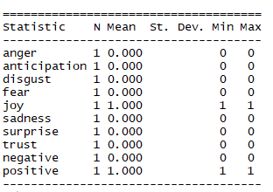
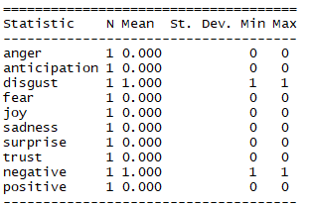
Examples
Beautiful
Ugly

Slide 25
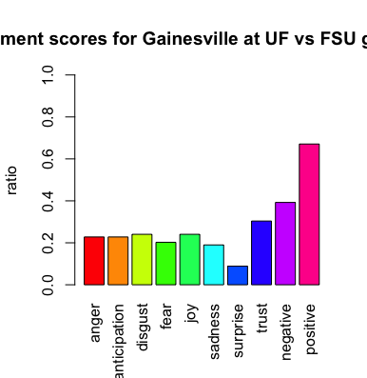
Sentiment scores for Gainesville

Slide 26
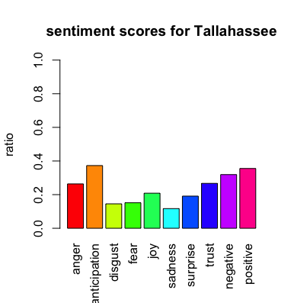
Sentiments scores for Tallahassee

Slide 27
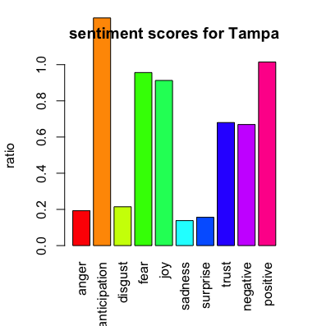
Sentiment Scores for Tampa

Slide 28
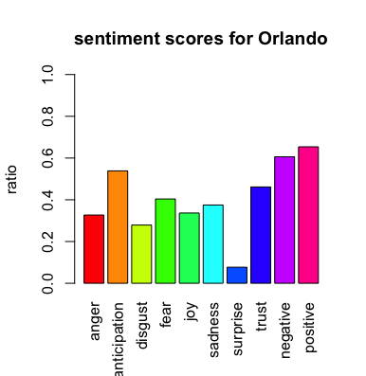
Sentiment scores for Orlando

Slide 29
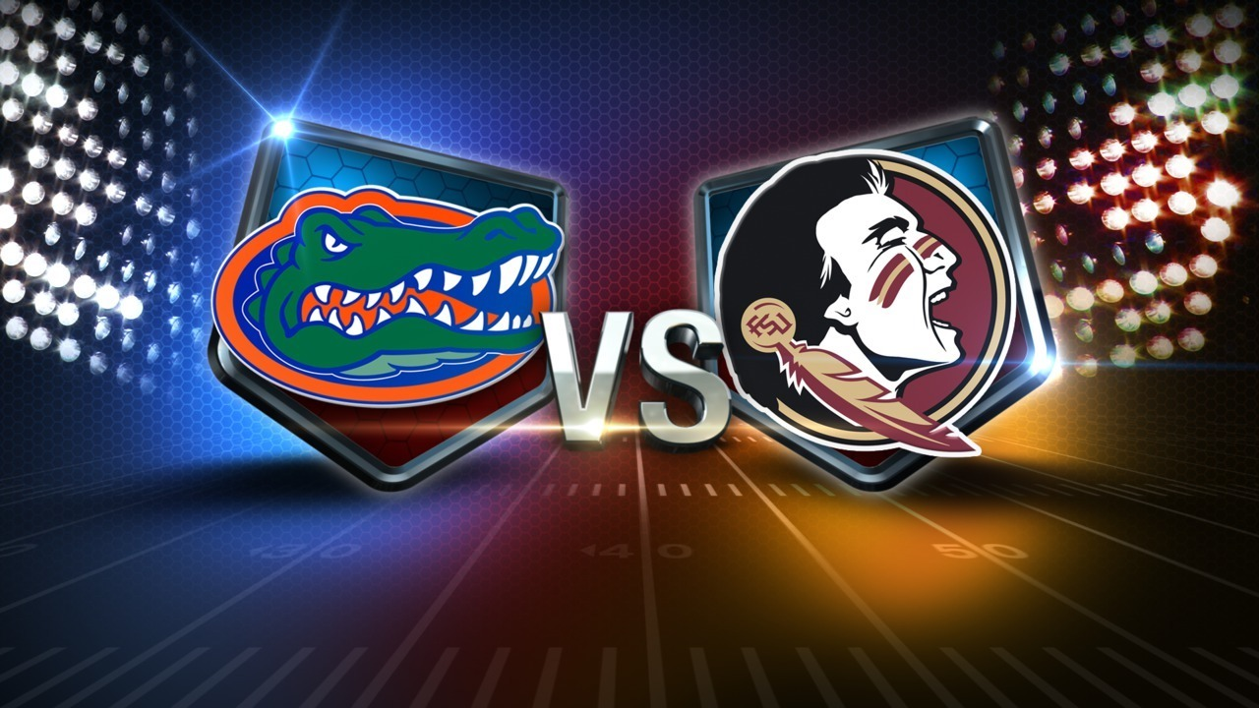
Conclusion
There is statistical significant differences in terms of the sentiment across cities.(GNV is different from Tampa, and Tallahassee is different from both Orlando and Tampa)
Negative sentiment is negative on the matchup more so than negative on either team.
Very little commentary about the actual game. People may not have been watching or felt uninspired.

Slide 30
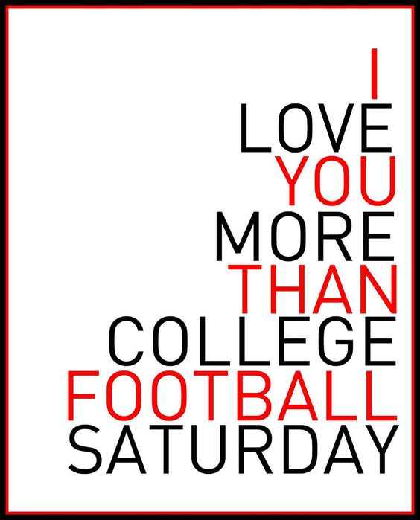
limitation AND FURTHER STUDY
Only use “UF+FSU” as key word. If we search the coaches and players the sentiment result may be different.
There are certain unreadable symbol in the text which result a partial data losing.
Guilianotti (2002, p.37) reported that failure to deliver on a school's "market promises," i.e., attracting better players and winning more games, inevitably causes some fans to seek other recreational activities as substitutes for college football attendance.
Further study should evaluate a highly anticipated matchup for comparison
Further study could also evaluate more locations to better evaluate the reach of the event and the sentiments expressed towards each university

Slide 31
REFERENCES
Gaines, C. (2014). College football reaches record $3.4 billion in revenue. Business Insider. Retrieved from http://www.businessinsider.com/college-football-revenue-2014-12.
Goff, B. (2000). Effects of university athletics on the university: A review and extension of empirical assessment. Journal of Sport Management, 14(2), 85-104.
Guilianotti, R. (2002). Supporters, Followers, Fans, and Flaneurs. Journal of Sport and Social Issues 26(1), 25-46.
Mixon, F. G., & Trevino, L. J. (2005). From kickoff to commencement: The positive role of intercollegiate athletics in higher education. Economics of Education Review, 24(1), 97-102.
Nixon, H. L. (2014). The athletic trap: How college sports corrupted the academy. Baltimore, MD: JHU Press.
Pope, D. G., & Pope, J. C. (2009). The impact of college sports success on the quantity and quality of student applications. Southern Economic Journal, 750-780.
Toma, J. D. (2003). Football U.: Spectator sports in the life of the American university. Ann Arbor, MI: University of Michigan Press

